Slide 1


ATTENDANCE AUTHENTICATION USING SIAMESE NETWORKS

Slide 2

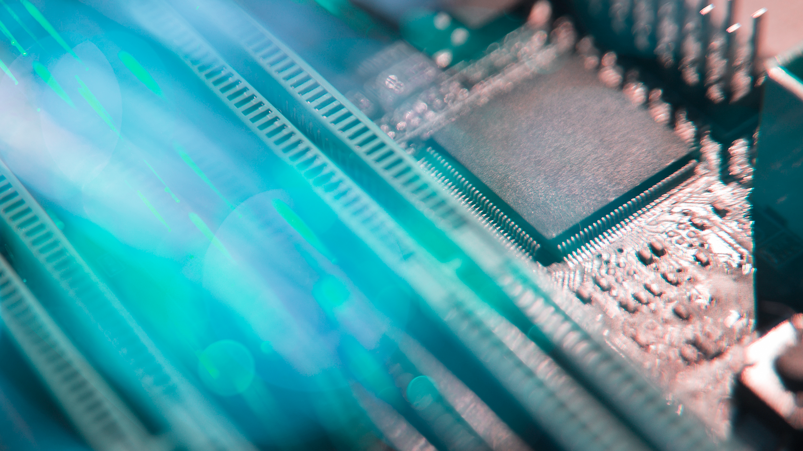
ROSHAN S- 19BCE1583
SAADHIKHA SHREE S- 19BPS1075
SRUTHIKA B- 19BPS1112
TEAM

Slide 3
CSE4019-IMAGE PROCESSING REVIEW - 3

Slide 4

INTRODUCTION
The information age is quickly revolutionising the way transactions are completed. Everyday actions are increasingly being handled electronically, instead of with pen and paper or face to face. This growth in electronic transactions has resulted in a greater demand for fast and accurate user identification and authentication. Access codes for buildings, bank accounts, and computer systems often use PIN’s for identification and security clearances.
Using proper PIN gains access, but the user of the PIN is not verified. When credit and ATM cards are lost or stolen, an unauthorised user can often come up with the correct personal codes. Despite warning, many people continue to choose easily guessed PIN’s and passwords: birthdays, phone numbers.
This brings out the need for biometrics.

Slide 5
WHAT IS BIOMETRICS?
A Biometric is an unique, measurable characteristic of a human being that can be used to automatically recognise an individual or verify an individual’s identity. Biometrics can measure both physiological and behavioral characteristics.
Physical biometrics include:
Finger – scan
Facial recognition
Iris – scan
Retina – scan
Hand – scan

Slide 6
WHY DID WE CHOOSE FACIAL RECOGNITION?
One common type of recognition system, which is even used in our university is: Finger – scan based biometrics.
But, due to the current pandemic situation, the usage of finger biometrics is not safe.
That’s the motivation to enhance to the current facial recognition models, and present a more accurate model.

Slide 7

VERIFICATION & ACCURACY
MODEL & DATASET
01
03
IMPLEMENTATION
FUTURE SCOPE
02
04

Slide 8
MODEL & DATASET
01

Slide 9
METHODOLOGY
ANCHOR IMAGE
POSITIVE/NEGATIVE IMAGE
VERIFICATION:
1 – VERIFICATION SUCCEEDED
0 – VERIFICATION FAILED

Slide 10
DATA SETS USED
ANCHOR IMAGES: One shot images personally created while entering a user’s facial information into the database. This is the image which is used to verify the users.
POSITIVE IMAGES: Images that are similar and matches the user’s face (which is the anchor image). Output from the model would be 1.
NEGATIVE IMAGES: Images that don’t match any of the anchor images, and results in verification failure. Output from the model would be 0.
The Anchor images and positive images dataset is personally created by me (user data), for the negative images used during model training has been obtained from the “Labelled faces in the wild” data set.

Slide 11
IMPLEMENTATION
02

Slide 12

SIAMESE NETWORK MODEL
Research paper describing the model:
https://www.cs.cmu.edu/~rsalakhu/papers/oneshot1.pdf
One particularly interesting task is classification under the restriction that we may only observe a single example of each possible class before making a prediction about a test instance. This is called one-shot learning

Slide 13
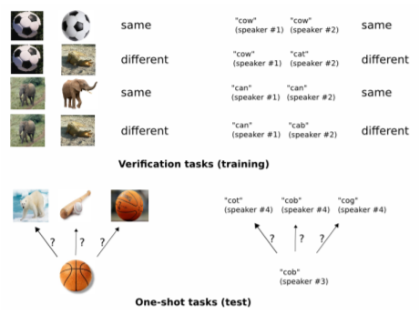
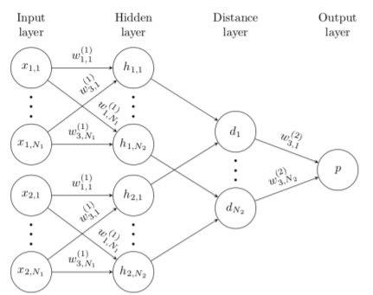
SIAMESE NETWORK MODEL

Slide 14
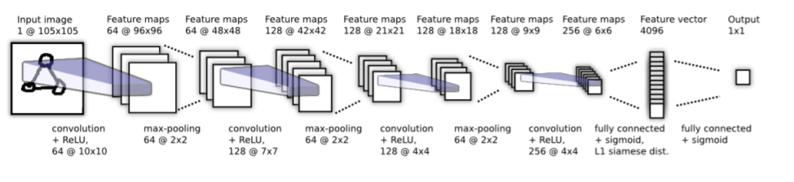
SIAMESE NETWORK MODEL

Slide 15
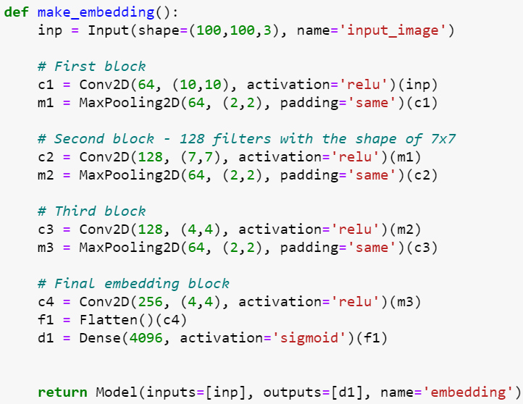
SIAMESE NETWORK MODEL - CODE

Slide 16
STEPS IN BUILDING THE MODEL
Setup
Collect positives and anchors
Load and preprocess images
Model Engineering
Training
Evaluate and save the model
Real time test

Slide 17
VERIFICATION TEST AND ACCURACY
03

Slide 18
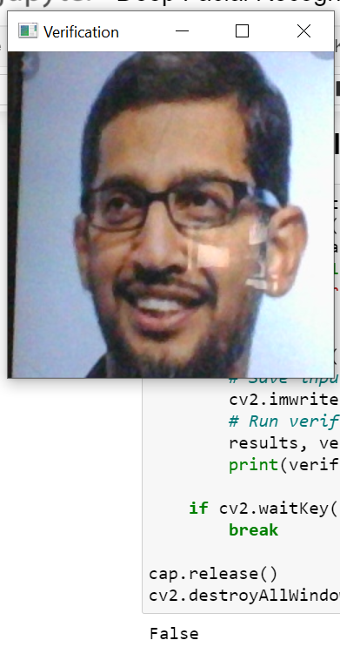
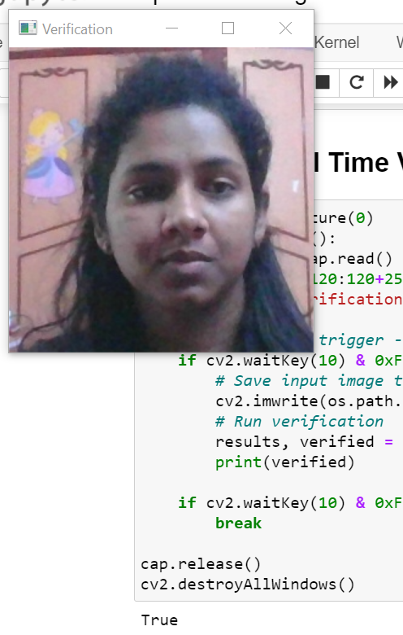
VERIFICATION TEST
The model returns True for verifying person’s face, whereas, for some other face (here Sundar Pichai), returns False value. This shows the model to be accurate.
Accuracy : 88.56%

Slide 19
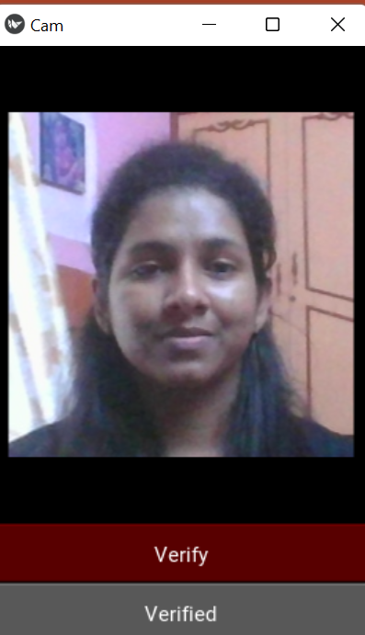
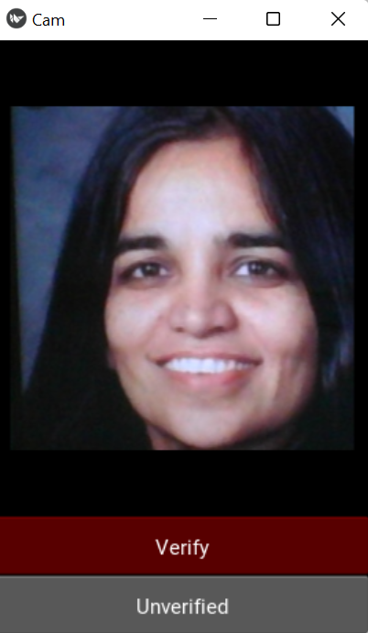
VERIFICATION AFTER BUILDING THE APP
The model returns True for verifying with person’s face, whereas, for some other face (here Kalpana Chawla), returns False value. This shows the model to be accurate.
Accuracy : 88.56%

Slide 20
FUTURE SCOPE
04

Slide 21
FUTURE SCOPE
This model can be expanded to store a variety of faces, instead of just single person’s data. This would be really helpful for attendance systems, and for credit card verifications too, because multiple users like family members can use the same card.

Slide 22
REFERENCES:
NEGATIVE DATASET
SIAMESE NETWORK PAPER
TENSORFLOW DOCUMENTATION
“LABELLED FACES IN THE WILD DATASET”
http://vis-www.cs.umass.edu/lfw/
https://www.cs.cmu.edu/~rsalakhu/papers/oneshot1.pdf
https://www.tensorflow.org/api_docs

Slide 23

THANK YOU

